Slide 1

Oracle 12c: SQL
Chapter 10
Selected Single-Row Functions
©2016. Cengage Learning. All rights reserved.

Slide 2
Objectives
Use the UPPER, LOWER, and INITCAP functions to change the case of field values and character strings
Manipulate character substrings with the SUBSTR and INSTR functions
Nest functions inside other functions
Determine the length of a character string using the LENGTH function
Use the LPAD and RPAD functions to pad a string to a certain width
Use the LTRIM and RTRIM functions to remove specific characters strings
Substitute character string values with the REPLACE and TRANSLATE functions
©2016. Cengage Learning. All rights reserved.

Slide 3
Objectives (continued)
Round and truncate numeric data using the ROUND and TRUNC functions
Return the remainder only of a division operation using the MOD function
Use the ABS function to set numeric values as positive
Use the POWER function to raise a number to a specified power
Calculate the number of months between two dates using the MONTHS_BETWEEN function
Manipulate date data using the ADD_MONTHS, NEXT_DAY, LAST_DAY, and TO_DATE functions
©2016. Cengage Learning. All rights reserved.

Slide 4
Objectives (continued)
Differentiate between CURRENT_DATE and SYSDATE values
Extend pattern matching capabilities with regular expressions
Identify and correct problems associated with calculations involving NULL values using the NVL function
Display dates and numbers in a specific format with the TO_CHAR function
Perform condition processing similar to an IF statement with the DECODE function
Use the SOUNDEX function to identify character phonetics
Convert string values to numeric with the TO_NUMBER function
Use the DUAL table to test functions
©2016. Cengage Learning. All rights reserved.

Slide 5
Terminology
Function – predefined block of code that accepts arguments
Single-row function – returns one row of results for each record processed
Multiple-row function – returns one result per group of data processed (covered in the next chapter)
©2016. Cengage Learning. All rights reserved.

Slide 6
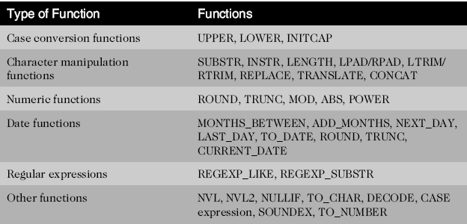
Types of Functions
©2016. Cengage Learning. All rights reserved.

Slide 7
Case Conversion Functions
Case conversion functions alter the case of data stored in a column or character string
  Used in a SELECT clause, they alter the appearance of the data in the results
  Used in a WHERE clause, they alter the value for comparison
©2016. Cengage Learning. All rights reserved.

Slide 8
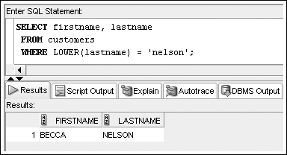
LOWER Function
Used to convert characters to lowercase letters
©2016. Cengage Learning. All rights reserved.

Slide 9
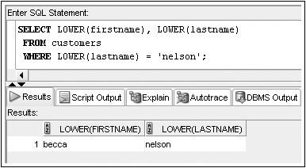
Lower Function
Used to convert characters to mixed case
©2016. Cengage Learning. All rights reserved.

Slide 10
UPPER Function
Used to convert characters to uppercase letters
It can be used in the same way as the LOWER function
  To affect the display of characters, it is used in a SELECT clause
  To modify the case of characters for a search condition, it is used in a WHERE clause
The syntax for the UPPER function is UPPER(c)
  Where c is the character string or field to be converted into uppercase characters
©2016. Cengage Learning. All rights reserved.

Slide 11
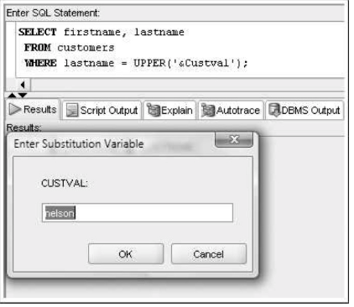

Slide 12
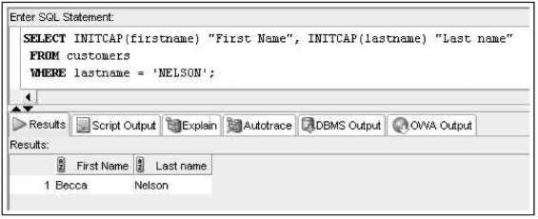
INITCAP Function
Used to convert characters to mixed case
©2016. Cengage Learning. All rights reserved.

Slide 13
Character Manipulation Functions
Character manipulation functions manipulate data by extracting substrings, counting the number of characters, replacing strings, etc.
©2016. Cengage Learning. All rights reserved.

Slide 14
SUBSTR Function
Used to return a substring, or portion of a string
©2016. Cengage Learning. All rights reserved.

Slide 15
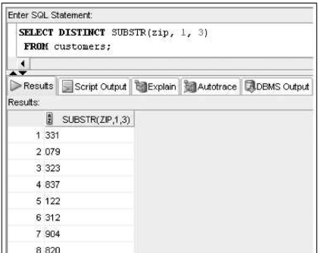
SUBSTR Function
Used to return a substring, or portion of a string

Slide 16
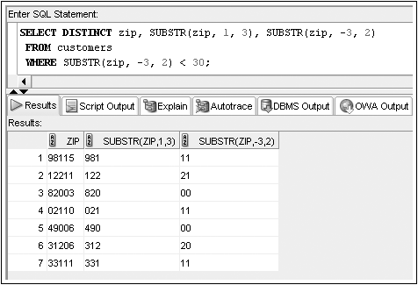
SUBSTR Function
Used to return a substring, or portion of a string

Slide 17
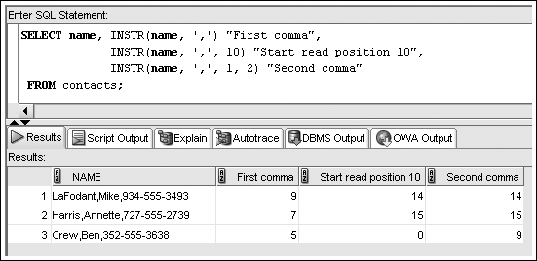
INSTR Function
The INSTR function searches a string for a specified set of characters or a substring, and then returns a numeric value representing the first character position in which the substring is found.

Slide 18
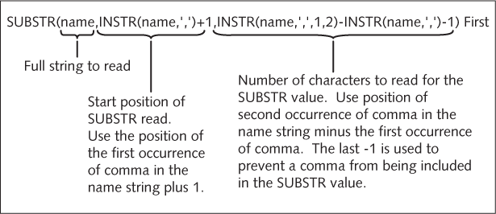
Nesting Functions
©2016. Cengage Learning. All rights reserved.

Slide 19
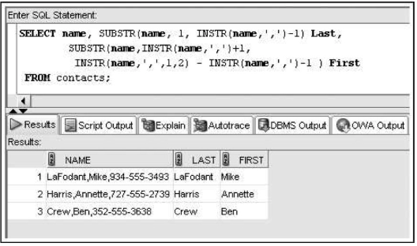

Slide 20
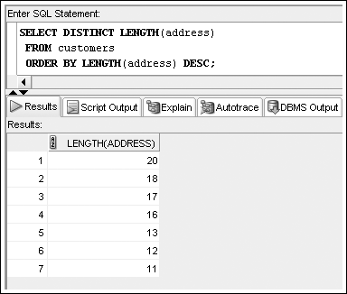
LENGTH Function
Used to determine the number of characters in a string

Slide 21
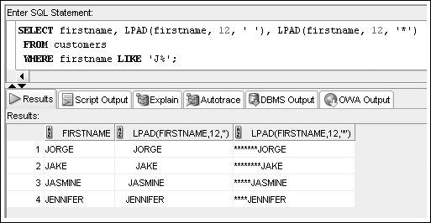
LPAD and RPAD Functions
Used to pad, or fill in, a character string to a fixed width

Slide 22
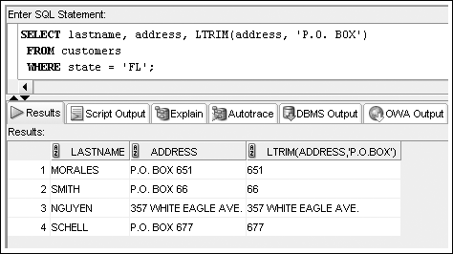
LTRIM and RTRIM Functions
Used to remove a specific string of characters

Slide 23
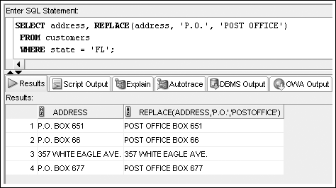
REPLACE Function
Substitutes a string with another specified string
©2016. Cengage Learning. All rights reserved.

Slide 24
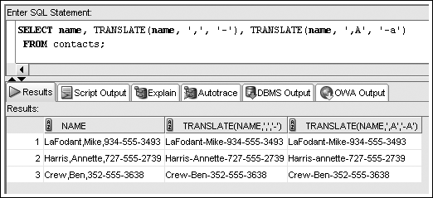
TRANSLATE Function
Used to replace a character in a string with a new value.
©2016. Cengage Learning. All rights reserved.

Slide 25
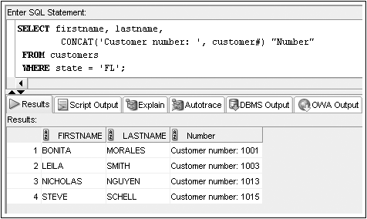
CONCAT Function
Used to concatenate two character strings
©2016. Cengage Learning. All rights reserved.

Slide 26
Number Functions
Allow for manipulation of numeric data
  ROUND
  TRUNC
  MOD
  ABS
©2016. Cengage Learning. All rights reserved.

Slide 27
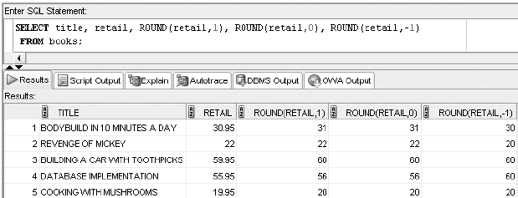
ROUND Function
Used to round numeric columns to a stated precision
©2016. Cengage Learning. All rights reserved.

Slide 28
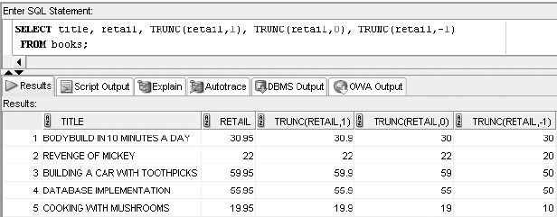
TRUNC Function
Used to truncate a numeric value to a specific position
©2016. Cengage Learning. All rights reserved.

Slide 29
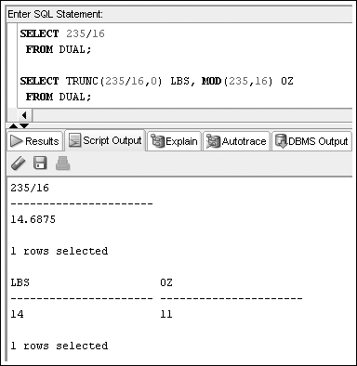
MOD Function
Returns only the remainder of a division operation.

Slide 30
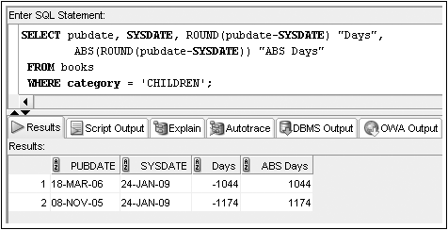
ABS Function
Returns the absolute, or positive, value of the numeric values supplied as the argument.

Slide 31
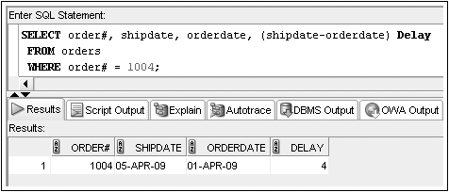
Date Functions
Used to perform date calculations or format date values
Subtract date for number of days difference
©2016. Cengage Learning. All rights reserved.

Slide 32
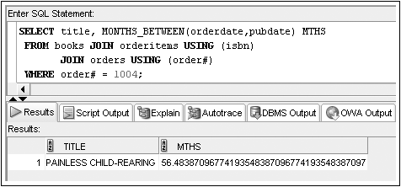
MONTHS_BETWEEN Function
Determines the number of months between two dates
©2016. Cengage Learning. All rights reserved.

Slide 33
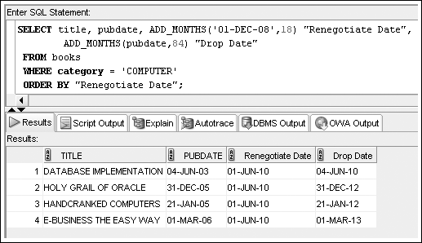
ADD_MONTHS Function
Adds a specified number of months to a date
©2016. Cengage Learning. All rights reserved.

Slide 34
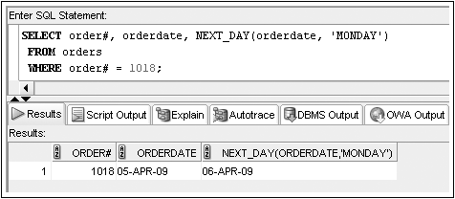
NEXT_DAY Function
Determines the next occurrence of a specified day of the week after a given date
©2016. Cengage Learning. All rights reserved.

Slide 35
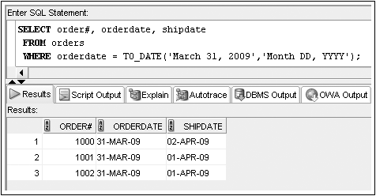
TO_DATE Function
Converts various date formats to the internal format (DD-MON-YY) used by Oracle 11g
©2016. Cengage Learning. All rights reserved.

Slide 36
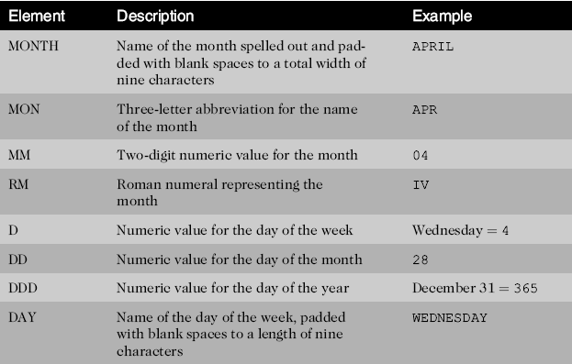
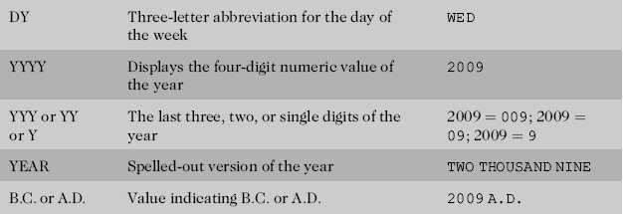
Format Model Elements - Dates
©2016. Cengage Learning. All rights reserved.

Slide 37
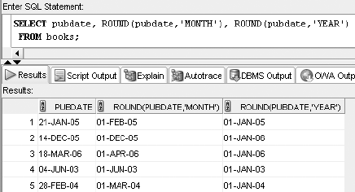
ROUND Function
A date can be rounded by the unit of month or year. For month rounding, if the day of the month is 16 or later, the date is rounded up to the first of the next month. Year rounding works similarly, with July 16th as the cutoff to determine rounding.
©2016. Cengage Learning. All rights reserved.

Slide 38
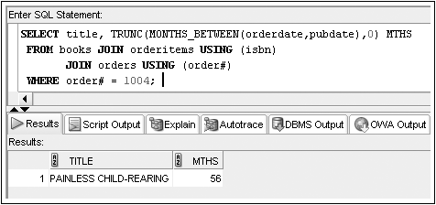
TRUNC Function
The nested MONTHS_BETWEEN function is followed by a comma, a zero, and a parenthesis, which serve to complete the TRUNC function. The zero indicates there should be no decimal positions
©2016. Cengage Learning. All rights reserved.

Slide 39
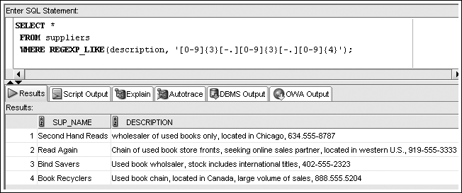
Regular Expressions
Regular expressions allow the description of complex patterns in textual data
©2016. Cengage Learning. All rights reserved.

Slide 40
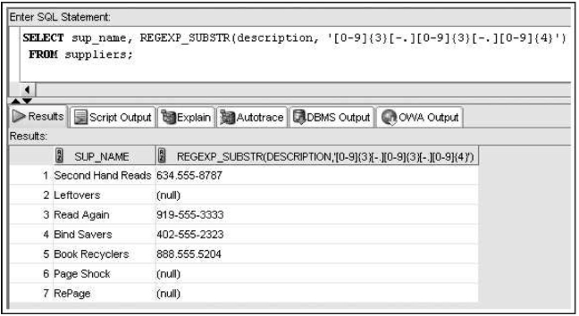
The first argument indicates which value should be searched (the Description column, in this case). The second argument identifies the pattern it’s attempting to locate in the search value.

Slide 41
Other Functions
NVL
NVL2
TO_CHAR
DECODE
SOUNDEX
©2016. Cengage Learning. All rights reserved.

Slide 42
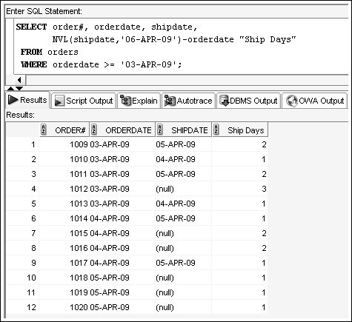
NVL Function
Substitutes a value for a NULL value

Slide 43
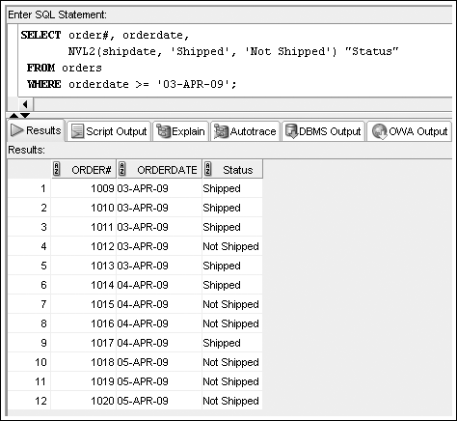
NVL2 Function
Allows different actions based on whether a value is NULL
NVL2(x, y, z) y represents what should be substituted if x isn’t NULL, and z represents what should be substituted if x is NULL.

Slide 44
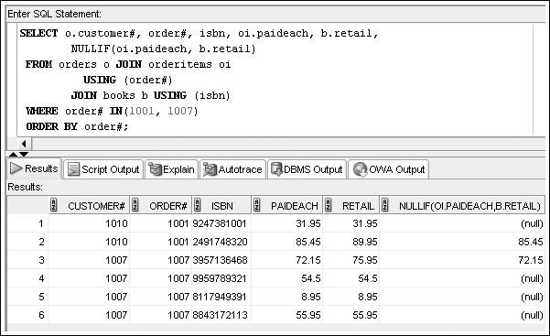
NULLIF Function
Used to compare two values for equality, if the two values are equal, the function returns a NULL value, otherwise it returns the first value

Slide 45
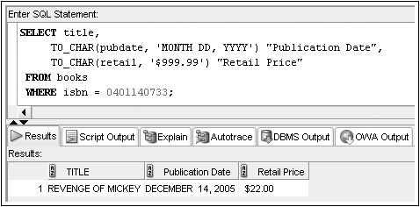
TO_CHAR Function
Converts dates and numbers to a formatted character string
©2016. Cengage Learning. All rights reserved.

Slide 46
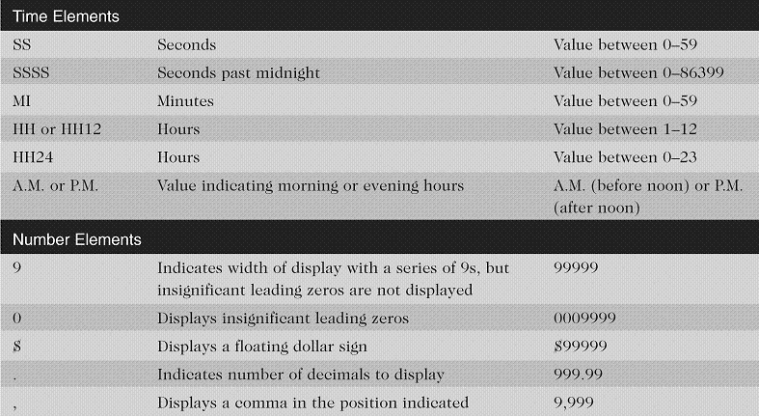
Format Model Elements –
Time and Number
©2016. Cengage Learning. All rights reserved.

Slide 47
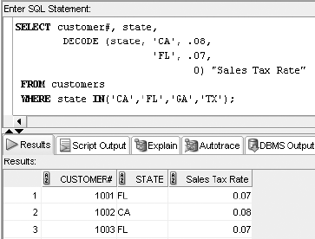
DECODE Function
Determines action based upon values in a list
DECODE(V, L1, R1, L2, R2, ..., D), where V is the value you’re searching for, L1 represents the first value in the list, R1 represents the result to return if L1 and V are equivalent, and so on, and D is the default result to return if no match is found.

Slide 48
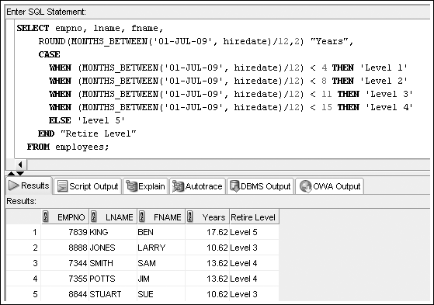
CASE Expression
The CASE expression is similar to the DECODE,but it can perform IF . . . THEN . . . ELSE conditional processing.

Slide 49
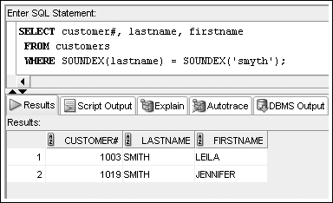
SOUNDEX Function
References phonetic representation of words

Slide 50
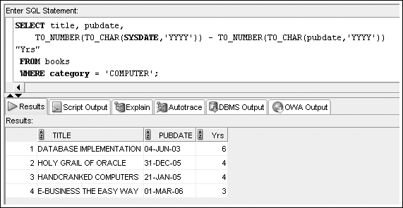
TO_NUMBER Function
Converts a value to a numeric datatype, if possible.
©2016. Cengage Learning. All rights reserved.

Slide 51
DUAL Table
Dummy table
Consists of one column and one row
Can be used for table reference in the FROM clause
Rarely used in the industry, it can be valuable for someone learning how to work with functions or testing new functions.
©2016. Cengage Learning. All rights reserved.

Slide 52
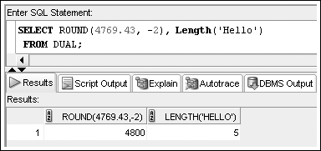
Using DUAL
If you want to practice rounding numbers or determining the length of character strings, you can enter a specific value in the function you’re practicing and reference the DUAL table in the FROM clause,
©2016. Cengage Learning. All rights reserved.

Slide 53
Summary
Single-row functions return a result for each row or record processed
Case conversion functions such as UPPER, LOWER, and INITCAP can be used to alter the case of character strings
Character manipulation functions can be used to extract substrings (portions of a string), identify the position of a substring in a string, replace occurrences of a string with another string, determine the length of a character string, and trim spaces or characters from strings
Nesting one function within another allows multiple operations to be performed on data
©2016. Cengage Learning. All rights reserved.

Slide 54
Summary (continued)
Simple number functions such as ROUND and TRUNC can round or truncate a number on both the left and right side of a decimal
The MOD function is used to return the remainder of a division operation
Date functions can be used to perform calculations with dates or to change the format of dates entered by a user
Regular expressions enable complex pattern matching operations
The NVL, NVL2, and NULLIF functions are used to address problems encountered with NULL values
©2016. Cengage Learning. All rights reserved.

Slide 55
Summary (continued)
The TO_CHAR function lets a user present numeric data and dates in a specific format
The DECODE function allows an action to be taken to be determined by a specific value
The searched CASE expression enables you to evaluate conditions to determine the resulting value
The SOUNDEX function looks for records based on the phonetic representation of characters
The DUAL table can be helpful when testing functions
©2016. Cengage Learning. All rights reserved.

